Slide 1
DB Design
Database Planning
Database Design
Normalization

Slide 2
DB Planning

Slide 3
Stages in Database Design
Analyze user environment
Develop conceptual data model
Choose a DBMS
Develop logical model, by mapping conceptual model to DBMS
Develop physical model
Implement physical model

Slide 4
Four Levels of Data
Real world
Enterprise in its environment
Mini-world, or Universe of Discourse – part of the world that is represented in the database
Conceptual Model
Entities, entity sets, attributes, relationships
Often represented as ER (Entity Relationship), EER (Enhanced Entity Relationship) or UML (Unified Modeling Language) diagram
Logical model of database-intension
Metadata, data about data
Record types, data item types, data aggregates
Schema - stored in data dictionary, catalog
Data occurrences-extension
Database itself
Data instances
files

Slide 5
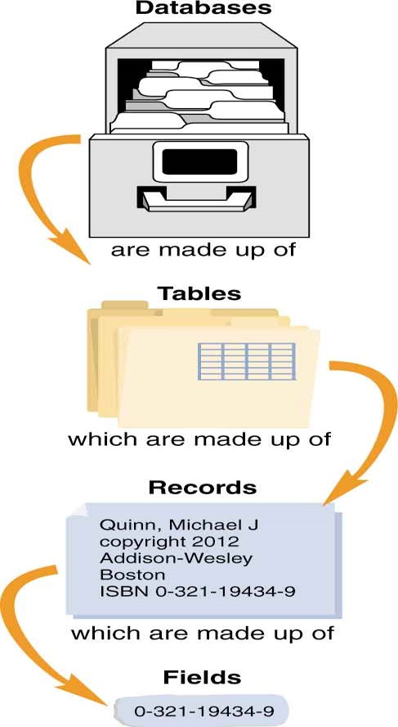
DB Design

Slide 6
The six basic steps for designing a data structure
Step 1: Identify the data elements
Step 2: Subdivide each element into its smallest useful components
Step 3: Identify the tables and assign columns
Step 4: Identify the primary and foreign keys
Step 5: Review whether the data structure is normalized
Step 6: Identify the indexes

Slide 7
Step 1: Identify the data elements
You can identify data elements in a variety of ways, including interviewing users, analyzing existing systems, and evaluating comparable systems.

Slide 9
Step 2: Subdivide the data elements
If a data element contains two or more components, you should consider subdividing the element into those components. That way, you won’t need to parse the element each time you use it.
The extent to which you subdivide a data element depends on how it will be used. Because it’s difficult to predict all future uses for the data, most designers subdivide data elements as much as possible.
When you subdivide a data element, you can easily rebuild it when necessary by concatenating the individual components.

Slide 10
A name that’s divided into first and last names

Slide 11
An address that’s divided into street address, city, state, and zip code

Slide 12
Step 3: Identify the tables and assign columns
You should divide the data elements into logic groups.
These logic groups will later become the tables of the database, and the elements will become the columns.

Slide 13
Step 4: Identify the primary and foreign keys
Each table should have a primary key that uniquely identifies each row.
The values of the primary keys should seldom, if ever, change. They should also be short and easy to enter correctly.
If possible, you should use an existing column for the primary key. But if a suitable column doesn’t exist, you can create an identity column that can be used as the primary key.
If two tables have a one-to-many relationship…
You may need to add a foreign key column to the table on the “many” side.
The foreign key column must have the same data type as the primary key column it’s related to.
E.g. Invoices table and Parts table

Slide 14
Step 4: Identify the primary and foreign keys (continued)
If two tables have a many-to-many relationship…
You’ll need to define a linking table to relate them.
Each of the tables in the many-to-many relationship will have a one-to-many relationship with the linking table.
If two tables have a one-to-one relationship…
They should be related by their primary keys.
This type of relationship is typically used to improve performance. Then, columns with large amounts of data can be stored in a separate table.

Slide 15
Two tables with a many-to-many relationship
Two tables with a one-to-one relationship

Slide 16
Foreign Keys
A foreign key is a column (or columns) that references column(s) (most often the primary key) of another table.
Use foreign keys to manage relationships / dependencies between tables
The foreign key column must have the same data type and value as the primary key column it’s related to. That means that all of the foreign keys in a foreign key table must have matching primary key values in the related table.

Slide 17
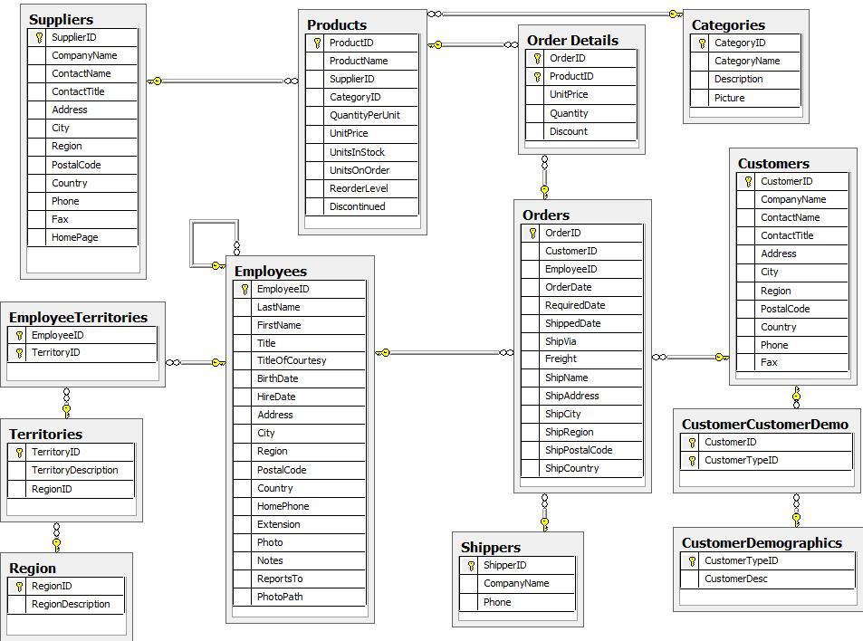
Northwind DB ER-Diagram

Slide 18
Step 5: Review whether the data structure is normalized
Normalization is a formal process you can use to separate the data in a data structure into related tables.
Normalization reduces data redundancy, which can cause storage, performance and maintenance problems.
In an un-normalized data structure, a table can contain information about two or more entities. It can also contain repeating columns, columns with repeating values, and data that’s repeated in two or more rows.
In a normalized data structure, each table contains information about a single entity, and each piece of information is stored in exactly one place.
To normalize a data structure, you apply the normal forms in sequence. There are seven normal forms, but a data structure is typically considered normalized if the first three are applied.

Slide 19

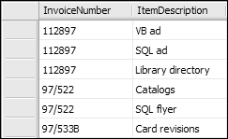
A table that contains repeating columns
A table that contains redundant data

Slide 20
Normalization

Slide 21
Normalization
“is the process of reducing redundant information in a database”
removing repeating data – makes the DB more efficient, easier to update
if we store the same data in multiple places, we run a risk of data inconsistencies

Slide 22
The three normal forms
Normal form | Description
First (1NF) | A table must not contain any repeating columns.
Second (2NF) | Every non-key column must depend on the entire primary key.
Third (3NF) | Every non-key column must depend only on the primary key.
Notes
Each normal form assumes that the design is already in the previous normal form.
A database is typically considered to be normalized if it is in third normal form.

Slide 23
The benefits of normalization
Since a normalized database has more tables than an unnormalized one, it also has more clustered indexes. That makes data retrieval more efficient.
Since each table contains information about a single entity, each index has fewer columns (usually one) and fewer rows. That makes data retrieval and insert, update, and delete operations more efficient.
Each table has fewer indexes, which makes insert, update, and delete operations more efficient.
Data redundancy is minimized, which simplifies maintenance and reduces storage.

Slide 24
Flat Design Example

Slide 25
Normal Forms
there are 3 normal forms:
1st normal form
2nd normal form
3rd normal form
each next normal form depends on the previous one being done

Slide 26
First Normal Form
divide data into logical units – tables
each table is assigned a primary key
primary key – one or more columns that uniquely identify a specific row in the table
ensure that there are no repeated groups
For a table to be in first normal form, its columns must not contain multiple, repeating values. Instead, each column must contain a single, atomic value.
In addition, the table must not contain repeating columns that represent a set of values.
A table in first normal form often has repeating values in its rows. This can be resolved by applying the second normal form.

Slide 27
Example – Course Info
we want to create a database to store information about this course and enrolled students

Slide 28
Example – Course Info
course number
course name
course instructor – name
course instructor – email
course instructor – phone number
course location
student – name
student – email
student – phone number
student status (enrolled, dropped, auditing course)
student grading method (pass/fail OR grade OR n/a)

Slide 29
Second Normal Form
For a table to be in second normal form, every non-key column must depend on the entire primary key.
To apply second normal form, you move columns that don’t depend on the entire primary key to another table and then establish a relationship between the two tables. (e.g. enrollment table)
Second normal form helps remove redundant row data, which can save storage space, make maintenance easier, and reduce the chance of storing inconsistent data.
Use foreign keys to manage relationships / dependencies between tables

Slide 30
Third Normal Form
For a table to be in third normal form, every non-key column must depend only on the primary key.
If a column doesn’t depend only on the primary key, it implies that the column is assigned to the wrong table or that it can be computed from other columns in the table.
A column that can be computed from other columns contains derived data (e.g. Invoices table total & sub-total).

Slide 32
Denormalizing a data structure
Data structures that are normalized to the fourth normal form and beyond typically require more joins than tables normalized to the third normal form and can therefore be less efficient.
SQL statements that work with tables that are normalized to the fourth normal form and beyond are typically more difficult to code and debug.
Most designers denormalize data structures to some extent, usually to the third normal form.
Denormalization can result in larger tables, redundant data, and reduced performance.
Only denormalize when necessary. It’s better to adhere to the normal forms unless it is clear that performance will be improved by denormalizing.

Slide 33
Best Practice
depends on the situation/company/team
usually somewhere between 2nd and 3rd

Slide 34

Naming Standards
select your names to be meaningful and communicate properly the intent of the table/column
use camel casing for table/column names
https://en.wikipedia.org/wiki/CamelCase
start with a capital letter; each word in the name will start with a capital letter as well
example: StudentId, FirstName, PhoneNumber…
do not use abbreviations, use whole words
spell things correctly
do not use underscores _, spaces or other special chars
feel free to use numbers, if it makes sense

Slide 35
Lab 1

